Slide 1
《英语国家社会与文化入门》(下册）
The Society and Culture
of Major English-Speaking Countries
An Introduction
(Book Two)

Slide 2
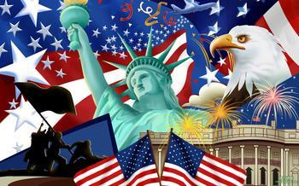
The United States of America
Unit 7 American Literature

Slide 3
Quiz
Give the English and a brief explanation for the following:
1 超验主义者
2 惠特曼
3 马克吐温
4 《荒原》
5 “迷惘的一代”

Slide 4
Focal Points
Washington Irving
James Fenimore Cooper
Transcendentalism
Henry David Thoreau
Nathaniel Hawthorne
Herman Melville
Walt Whitman
Mark Twain
naturalists
Sherwood Anderson and Sinclair Lewis
T. S. Eliot
the "Lost Generation"
William Faulkner
Eugene O'Neill
African-American writers

Slide 5
This Unit Is Divided into Five Sections
Early Fiction
Major Writers of the 19th Century
Major Writers at the Turn of the Century
Major Writers of the 20th Century
New American Voices

Slide 6
I. Early Fiction
Washington Irving (1783-1859): His History of New York is supposedly an account of the Dutch settlement of Manhattan Island. With this work Irving furnished America with its first myth-hero, Father Knickerbocker. In “Rip Van Winkle” and “The Legend of Sleepy Hollow”, Irving focused on America’s natural landscape and contributed even more memorable characters to his legendary recreation of the American past. He was among the first American writers to earn acclaim in Europe, and was also admired by some European writers, including Walter Scott, Lord Byron, and Charles Dickens. Irving encouraged American authors that followed him.

Slide 7
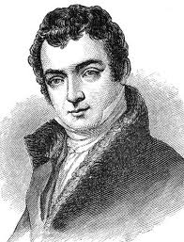
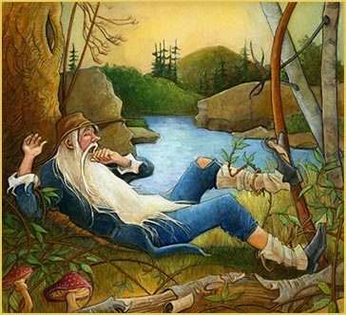
Washington Irving（1783-1859）
The story “Rip Van Winkle” is set before and after the American Revolution. The protagonist falls asleep in the mountain and wakes up to discover shocking changes: the American has taken place.

Slide 8
I. Early Fiction
James Fenimore Cooper (1789-1851): Cooper’s The Pioneers was the first of the five great romances known as the Leather-Stocking Tales. The author introduced in The Pioneers the fabulous woodsman, Natty Bumppo. He was the forerunner of all heroic forest scouts, bear hunters, and cowboys of later American novels and films. The Last of the Mohicans , The Prairie, The Pathfinder, and The Deerslayer pursued Natty’s career both forward and backward in time, from the first flush of manhood to his death as an old man on the western plains. He also imagined a bi-cultural and bi-racial friendship between Natty Bumppo and a Native American warrior, thereby projecting the fulfillment of the democratic dream which persists in American literature.

Slide 9
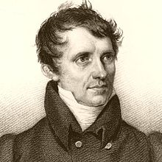
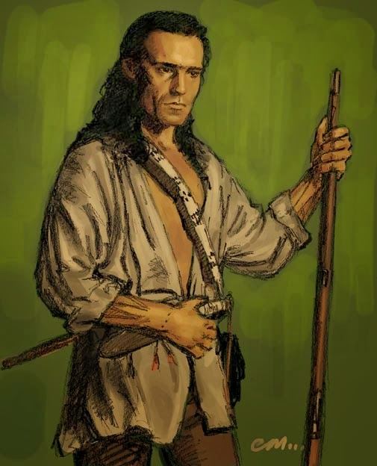
James Fenimore Cooper (1789-1851)
Natty Bumppo, although the child of white parents, grew up among Delaware Indians and was educated by Moravian Christians, becoming a fearless warrior.

Slide 10
II. Major Writers of the 19th Century
Ralph Waldo Emerson
Henry David Thoreau
Nathaniel Hawthorne
Herman Melville
Walt Whitman
Mark Twain
Emily Dickenson

Slide 11
II. Major Writers of the 19th Century
Ralph Waldo Emerson (1803-1882): In 1836 Emerson published his book Nature. In this work, Emerson claimed that by studying and responding to nature individuals could reach a higher spiritual state without formal religion. He was the representative of a circle of intellectuals who gathered around him, as “the Transcendentalists, based on their acceptance of Emerson’s theories about spiritual transcendence. Emerson’s other major work includes “The American Scholar” and “Self-Reliance”. Emerson wrote on a number of subjects, developing certain ideas such as individuality, freedom, the ability for humankind to realize almost anything, and the relationship between the soul and the surrounding world.

Slide 12
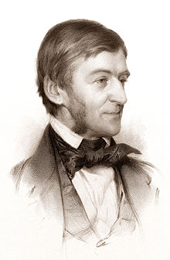
Ralph Waldo Emerson
Both during his lifetime and since his death, Emerson's reputation and influence have been enormous. He was acknowledged as a major thinker and author and as the central proponent of Transcendental philosophy. His efforts straddled a number of disciplines such as literature, philosophy, theology, psychology, education, and social commentary. He made important contributions to American thought and letters.

Slide 13
II. Major Writers of the 19th Century
Henry David Thoreau (1817-1862) was one of Emerson’s most gifted fellow-thinkers. Thoreau was passionate not only about individuals’ learning to think for themselves and being independent, both traditional American values, but also about the necessity for humans to live simply and to know and care for the place where they lived. In 1849 he published an essay titled “Civil Disobedience”. In it, Thoreau argues that individuals should not permit governments to overrule or atrophy their consciences, and that they have a duty to avoid allowing such acquiescence to enable the government to make them the agents of injustice. His commitment to passive resistance continues to influence social activists today.

Slide 14

Henry David Thoreau
Thoreau carried out his ideals by building a small cabin by a wooded pond, where he lived alone with only the company of natural creatures. His best-known book, Walden (1854), records his daily observations of the changing seasons and his convictions that living in close relation to nature is personally liberating and ethically rejuvenating. His commitment to living sustainably and to learning from nature continues to this day to influence environmental writers and environmental activists world-wide.
Thoreau’s House on Walden Pond

Slide 15
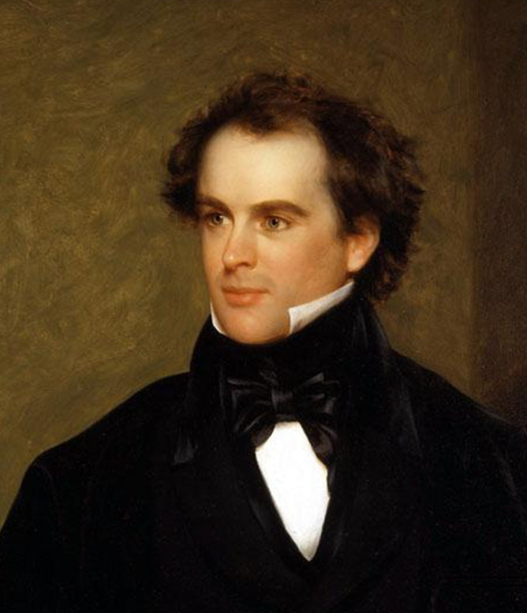
II. Major Writers of the 19th Century
Nathaniel Hawthorne (1804-1864) published a volume called Twice-Told Tales, stories rich in symbolism and peculiar incidents. His rebelled against the traditional New England outlook on life by writing imaginative “romances,” stories and novels which were not necessarily realistic but which were designed to explore certain moral themes such as guilt, pride and emotional repression.

Slide 16
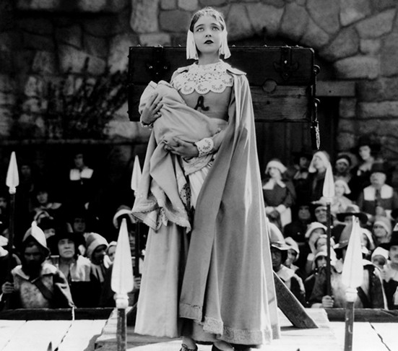
Nathaniel Hawthorne
Hawthorne wrote novels and many short stories. His masterpiece is The Scarlet Letter, a novel published in 1850. Set in the Puritan past, it is the stark drama of a woman harshly cast out from her community for committing the sin of adultery.

Slide 17
II. Major Writers of the 19th Century
Herman Melville (1819-1891), worked at many jobs before signing on in 1839 for the first of several sea voyages. Seven years later, he began writing accounts of his adventures on the open seas and in exotic ports, which won him instant success. Inspired by Hawthorne’s example, he wrote novels which scrutinized capitalism, colonialism, psychology, racism, philosophy, politics and religion. The public rejected them, however, and, discouraged, Melville published several short stories on difficult subjects such as homelessness and mutiny as well as several collections of poetry. Ironically, the very books that proved unacceptable during his lifetime are the ones most admired today.

Slide 18
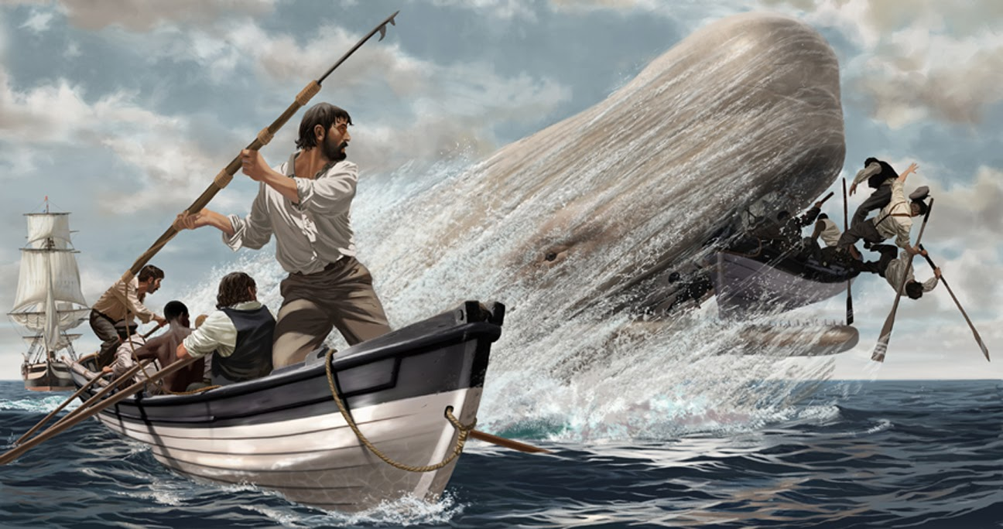
Melville’s masterpiece Moby Dick or The White Whale, published in 1851, uses a story of a whaling voyage to explore numerous profound themes questioning democracy and morality with which contemporary readers continue to grapple. Many consider it to be America’s greatest novel.

Slide 19
II. Major Writers of the 19th Century
Walt Whitman (1818-1892) was a great poet who asserted a truly American voice, one that celebrated the American landscape, the American people, their speech and democratic form of government. In 1855, he published a ground-breaking book called Leaves of Grass. His poetry was characterized by a free-flowing structure with its long irregular lines. Whitman ventured beyond traditional forms to meet his need for more space to express the American spirit. One of the poems is “The Song of Myself” in which Whitman dwelt on himself because he saw himself as a prototype of “The American.” It won Whitman admirers across America and in Europe. Throughout the rest of his life, he kept rewriting and republishing editions of Leaves of Grass. He celebrated a sweeping panorama of the American landscape and sang almost mystically of the rhythms of life uniting all citizens of the democracy.

Slide 20
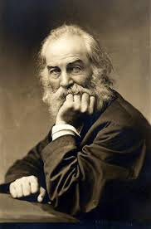

Walt Whitman

Slide 21
II. Major Writers of the 19th Century
Mark Twain (1835-1910) grew up in a small town on the banks of the Mississippi River and received only a basic public school education. Twain was a new voice, a man of the people. He captured a peculiarly American sense of humor, telling outrageous jokes and tall tales in a calm, innocent, matter-of-fact manner. He sometimes used local dialect for comic effect, but even his normal prose style sounded distinctively American. Twain had a cynical streak that matched the country’ skeptical post-Civil War mood. He soon developed beyond merely "regional" stories and turned to comic novels. His shrewd social satire was most apparent in books such as A Connecticut Yankee in King Arthur's Court.

Slide 22
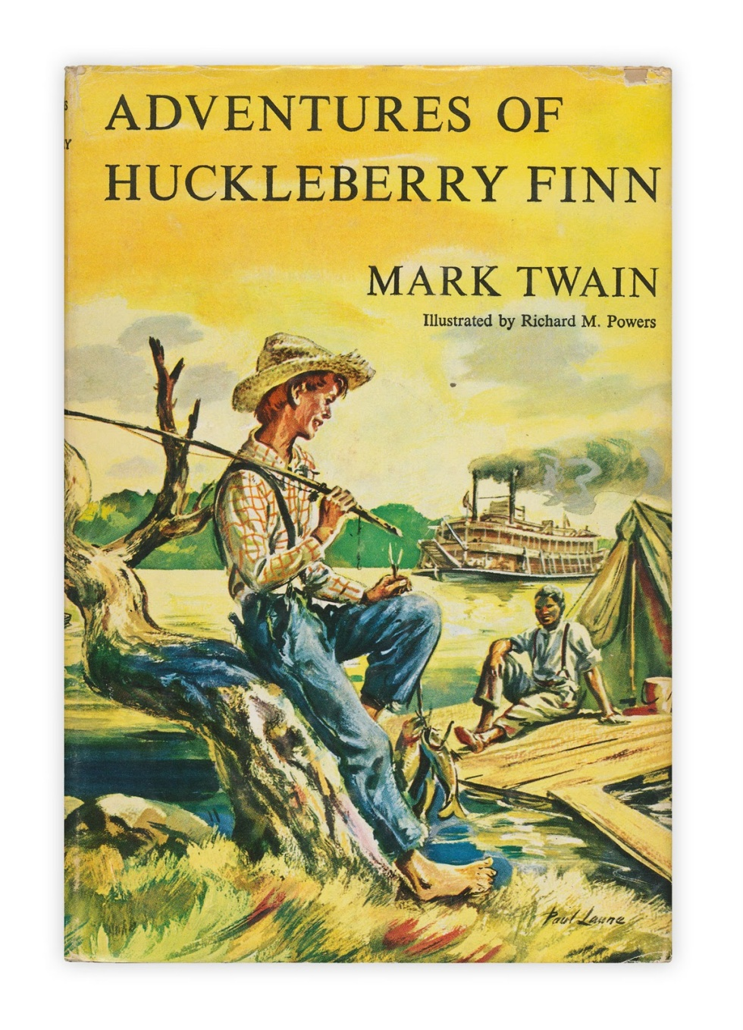
Mark Twain
Twain’s greatest book is The Adventures of Huckleberry Finn (1884). This is the story of a boy running away from home and steering a raft down the Mississippi River, but it is more than that. The people the boy meets cover the entire spectrum of humanity, and his voyage down the river becomes a metaphor for a journey through life. At the heart of Huck’s journey is his friendship with a runaway slave, Jim, who teaches him to be morally responsible.

Slide 23
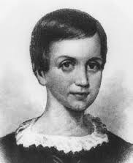
Emily Dickinson (1830-1886)
Emily Dickinson, deeply admired by later generations, was barely known while she lived. Her poetry mixed gaiety and gloom. She rarely left the grounds of the Dickinson household in Amherst, Massachusetts, but she displayed great power of imagination. She made poetic drama out of things close at hand as she was fascinated by life. Almost all of her poems are short, but they are charged with a surprising emotional force.

Slide 24
III. Major Writers at the Turn of the Century
“Naturalists” concentrated upon the grimmer aspects of reality and a deterministic view of life, linking them to European naturalists such as French novelist Emile Zola. William Dean Howells led the American realistic movement. Theodore Dreiser’s Sister Carrie in 1900 was considered shocking because it described young urban women who fell into sexual sin. Upton Sinclair’s The Jungle (1906) exposed the horrible lives of meat-packing factory workers. Jack London’ Call of the Wild (1903), the tale of a sled dog, was set in the snowy wilderness of the Northwest, where the discovery of gold had caused a rush of greedy prospectors. In this novel and other celebrated tales set in Alaska and in the South Pacific, London, relying on Social Darwinism, expressed his sense that primitive urges underlie all of life.

Slide 25
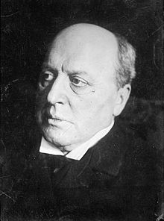
Henry James (1843-1016)
Henry James is regarded as one of the key figures of 19th-century literary realism. He wrote three brilliant novels, The Wings of the Dove, The Ambassadors and The Golden Bowl, in which he explored the fate of the individual.. These were chiefly wealthy, cultured Americans living in Europe, but, like the lower-class characters of the naturalists’ novels, James’ people were trapped in their environment, struggling to find happiness. James’ interest was psychological rather than social.

Slide 26

Edith Wharton (1862-1937)
Edith Wharton, from a wealthy family, wrote insightful novels and stories about high society. Her novel The House of Mirth tells the tragic story of a fading beauty falling victim to the hypocritical high society of New York. Her The Age of Innocence is another successful novel, in which she exposed her upper-class world as only an insider could.
The film of The Age of Innocence based on Wharton’s novel.

Slide 27
III. Major Writers at the Turn of the Century
Two other women, in different parts of the country, were also writing psychological studies. Kate Chopin’s （1851-1904） The Awakening is set in the heart of the South, in New Orleans, and she is now considered by some to have been a forerunner of the feminist authors of the 20th century. Willa Cather’s （1873-1947） O Pioneers! depicts life on the sweeping plains of Midwestern Nebraska. Cather went on to write several novels such as My Antonia, the Song of the Lark and One of Ours, for which she was awarded the Pulitzer Prize. She establish herself as a major American writer, but Chopin stopped writing after her book was condemned by literary critics.

Slide 28
IV. Major Writers of the 20th Century
Sherwood Anderson and Sinclair Lewis
T. S. Eliot
the "Lost Generation"
William Faulkner
Eugene O'Neill
African-American writers

Slide 29
IV. Major Writers of the 20th Century
As the United States became increasingly urban in the first decades of the 20th century, two major works of literature expressed a new attitude of rebellion against the limited life of the typical small American town. Sherwood Anderson (1876-1941) published a book of short stories called Winesburg, Ohio in 1919, a series of portraits of different personalities in one mid-western town, depicting narrow-minded ignorance and frustrated dreams.
Sinclair Lewis (1885-1951), published Main Street in 1920. In this book and others such as Babbitt and Arrowsmith, Lewis satirized the traditional “American dream” of success. He was awarded the Nobel Prize for Literature in 1930, the first American to be so honored.

Slide 30
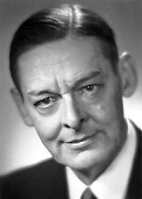
T.S. Eliot (1888 –1965)
Eliot was an essayist, publisher, playwright, literary and social critic. He was born in America, but emigrated to England in 1914 and became a British subject in 1927. Eliot’s poem “The Love Song of J. Alfred Prufrock” (1915) is seen as a masterpiece of the Modernist movement. It was followed by his best and long poem The Waste Land (1922), widely regarded as “one of the most important poems of the 20th century” and a central text in Modernist poetry. Eliot was awarded the Nobel Prize in Literature in 1948.

Slide 31

F. Scott Fitzgerald（1896-1940）
After WWI many novelists produced a literature of disillusionment, and they were known as “the Lost Generation.” F. Scott Fitzgerald’s (1896-1940) novels captured the restless, pleasure-hungry, defiant mood of the 1920s. Fitzgerald’s great theme, expressed in The Great Gatsby, is of youth’s golden dreams turning to disappointment.
Gatsby in the film played by Leonardo DiCaprio

Slide 32
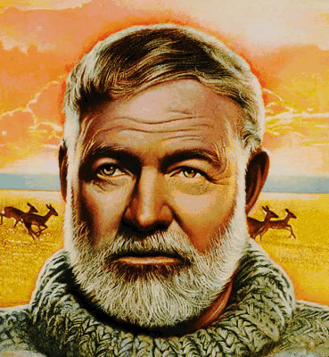
Ernest Hemingway (1899-1961)
War had also affected Hemingway. Having seen violence and death close at hand, Hemingway adopted a moral code exalting simple survival and the basic values of strength, courage and honesty. His main characters were usually tough, silent men, good at sports or war but awkward in their dealings with women. Among his best books are The Sun Also Rises, A Farewell to Arms and For Whom the Bell Tolls. He, too, eventually won the Nobel Prize.

Slide 33
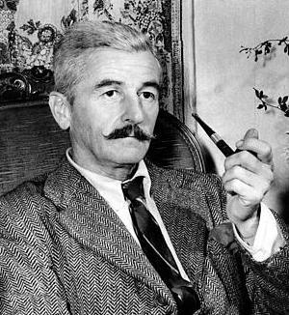
William Faulkner (1897-1962)
William Faulkner wrote 19 novels and nearly a hundred short stories. Though the setting of his fiction is often in the American South, he deals with major universal themes in literature. In terms of writing techniques, Faulkner is among the greatest experimentalists of the 20th century fiction. His major novels include The Sound and the Fury, As I Lay Dying, Light in August, and Absalom, Absalom! . In 1950 Faulkner won the Nobel Prize for Literature.

Slide 34

Eugene O’Neill (1888-1953)
O’Neill was a playwright and Nobel laureate in Literature. His depict characters on the fringes of society, where they struggle to maintain their hopes and aspirations, but ultimately slide into disillusionment and despair. His greatest theme was the individual’s search for identity. Among his major plays were Desire under the Elms and Long Day's Journey into Night.
Long Day’s Journey into Night on stage

Slide 35
IV. Major Writers of the 20th Century
African-American Writers:
-The 1920s saw the rise of an artistic black community centered in New York City in Harlem. New poets such as Langston Hughes (1902-1967) wrote about what it meant to be black. They used exotic images drawn from their African and slavery pasts, and incorporated the rhythms of black music into their poetry.
-Major African-American novelists include Zora Neale Hurston (1891-1960) who wrote a moving novel, Their Eyes Were Watching God, exploring the difficulties and the strengths of African-American women.
Richard Wright (1908-1960) published a disturbing novel Native Son in 1940, in which the black had been warped by this violent and cruel society. Ralph Ellison (1919-1994) was known for his novel Invisible Man whose hero was driven underground by the values of white society. James Baldwin’s (1924-1987) characteristic themes -- hatred of racism and celebration of sexuality -- were expressed in his novels like Go Tell It on the Mountain and in essays like “Nobody Knows My Name”.

Slide 36
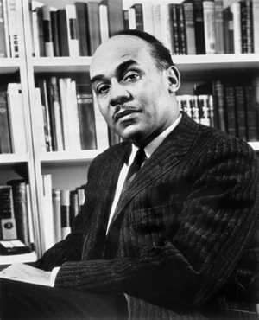
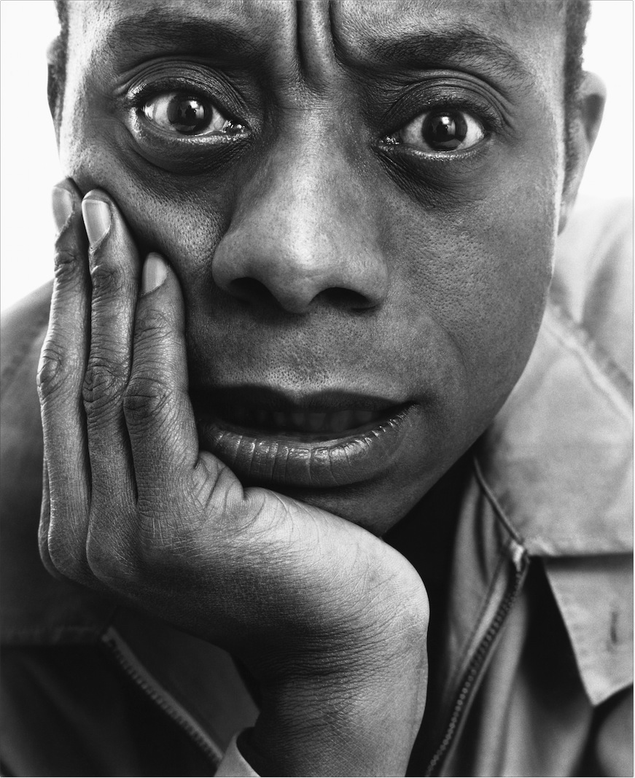
Ralph Ellison (left) and James Baldwin (right)

Slide 37
New American Voices
New writers keep emerging in American Literature. Some of them are :
Toni Morrison (1931- ) has published nine novels up to now, of which The Bluest Eye, Song of Solomon and Beloved are considered her best-known works. She won the Nobel Prize for Literature in 1993, the first African-American writer to receive this honor.
N. Scott Momaday (1934- ) published House Made of Dawn and The Way to Rainy Mountain, and he is usually regarded as the founding father of the Native American Renaissance. He won the Pulitzer Prize for Fiction in and received the National Medal of Arts.
Maxine Hong Kingston (1940-) wrote about her Chinese immigrant ancestors in The Woman Warrior and China Men. She has received several awards for her contributions to Chinese American Literature including the National Book Award for Nonfiction.
Alice Walker (1944- ) is an African-American writer. She wrote the novel The Color Purple for which she won the National Book Award and the Pulitzer Prize for Fiction.

Slide 38
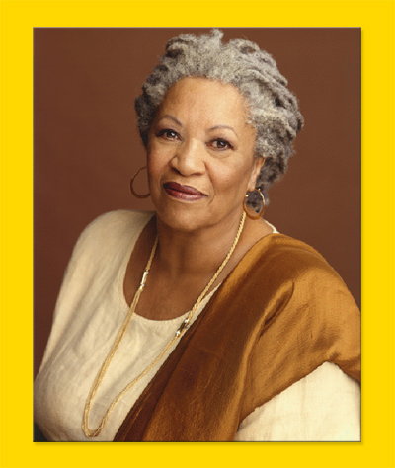
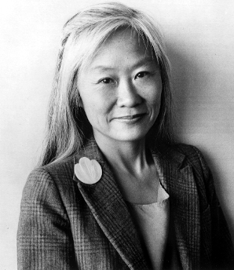
Tony Morrison (left) and Maxine Hong Kingston (right)

Slide 39
Questions for Discussion
What is the main theme in American Literature according to the author?
What theories does Emerson explain in his essays? Why are they so influential?
Why does Thoreau have a strong influence on environmental writers and activists today?
Why is Walt Whitman considered one of the most important poets in America?
Why did Mark Twain win so many readers at home and abroad?
Who is your most favorite American author? Why?

Slide 40
The End
高等教育出版社
2015

